Slide 1


Department of Immunology
Faculty of Medicine Siriraj Hospital Mahidol University
FEVER FROM THE FOREST:
The continuing emergence of arboviruses
Kobporn Boonnak, Ph.D.
Collaborative Strategy for One Heath Project Building
Chiang Mai
22 May 2023

Slide 2
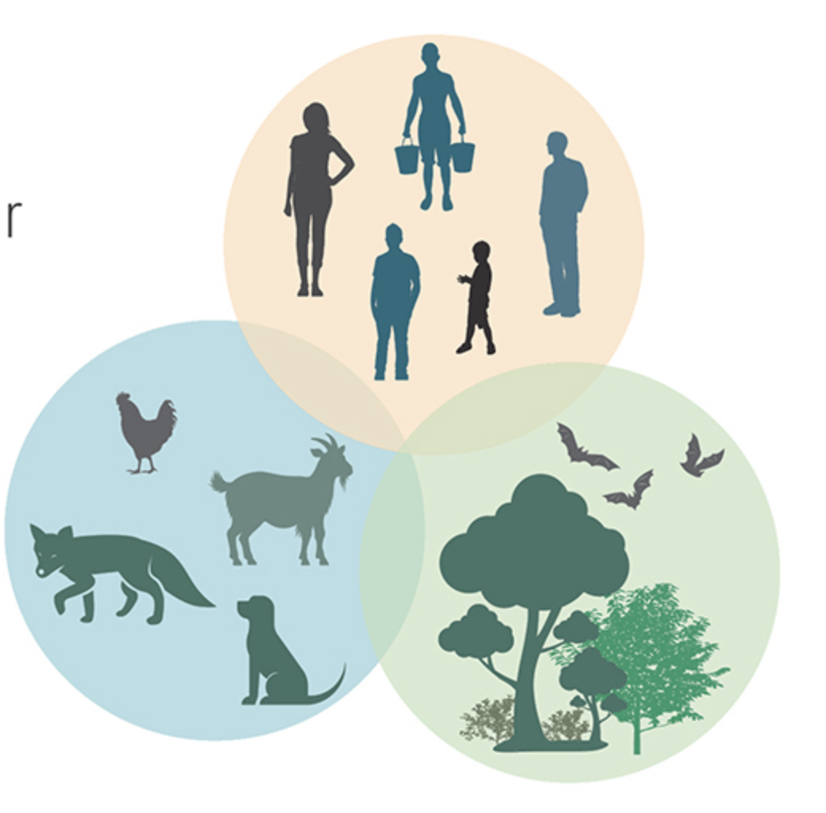
ONE HEALTH CONCEPT
“One Health is the idea that the health of people is connected to the health of animals and our shared environment.”
When we protect one, We help protect all.

Slide 3
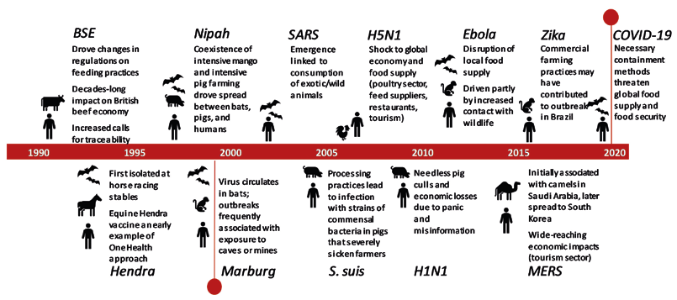
Timeline of significant emerging zoonoses outbreaks over the past 30 years
80% of zoonotic diseases are viruses

Slide 4
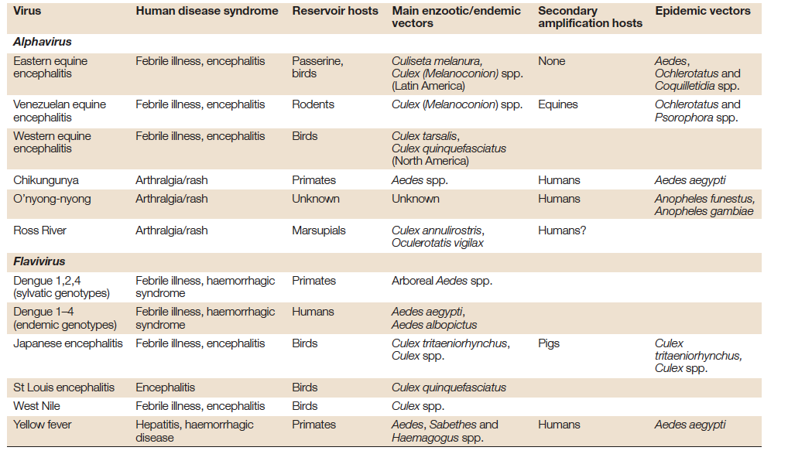
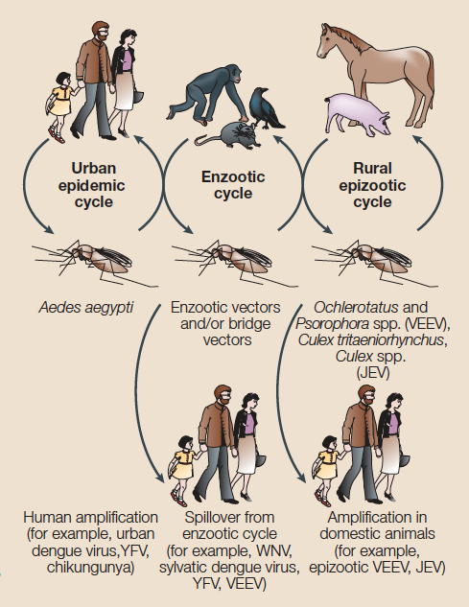
Typical mechanisms of arboviral emergence
Nature Reviews Microbiology volume 2, pages 789–801 (2004)

Slide 5
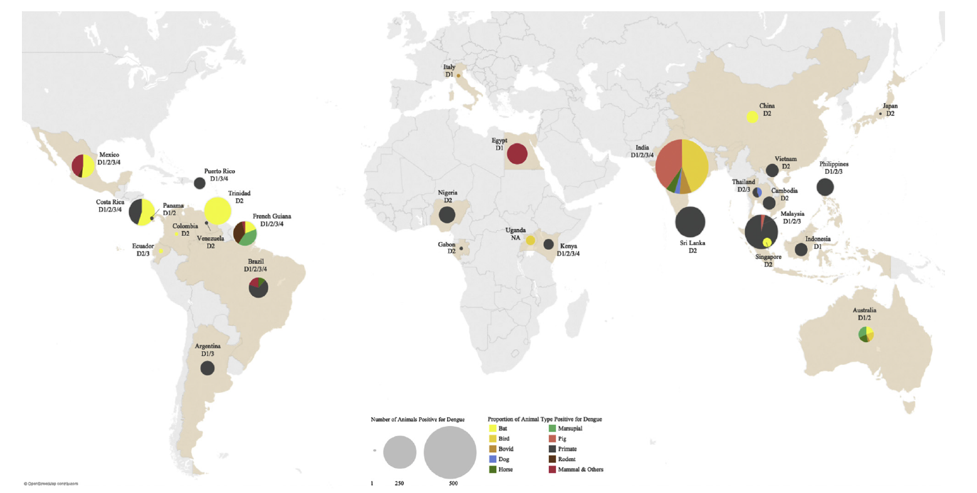
Literary Review
Geographic distribution and proportion of dengue positivity among different animal types
Dog
Primate
S.X.W. Gwee et al. One Health (2021)

Slide 6
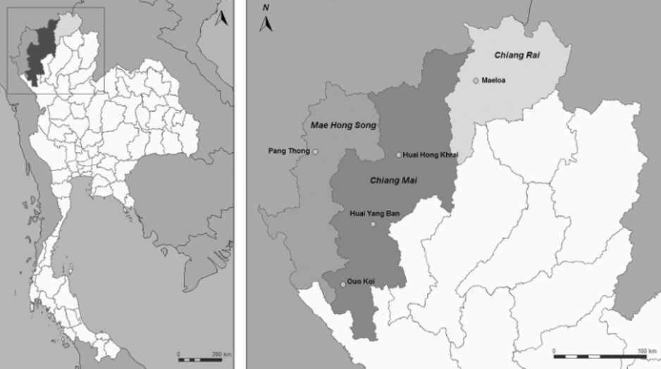
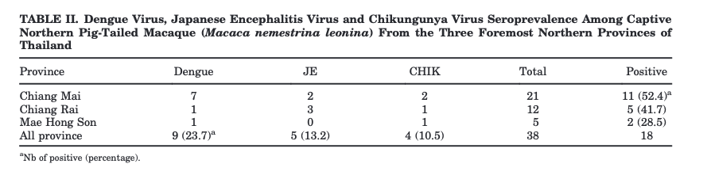
Previous Research Finding in Thailand
“The potential of macaque Macaca nemestrina
leonina in Thailand to be infected with arboviruses”
American Journal of Primatology 2014. 76:97-102

Slide 7
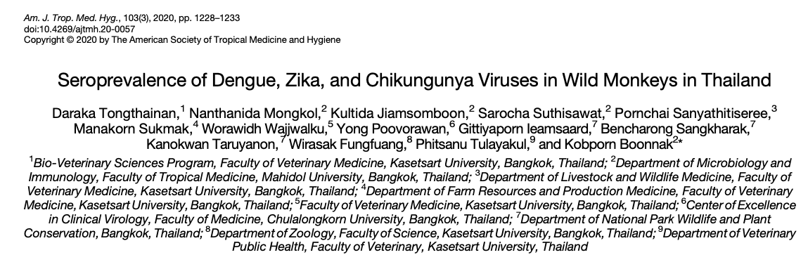
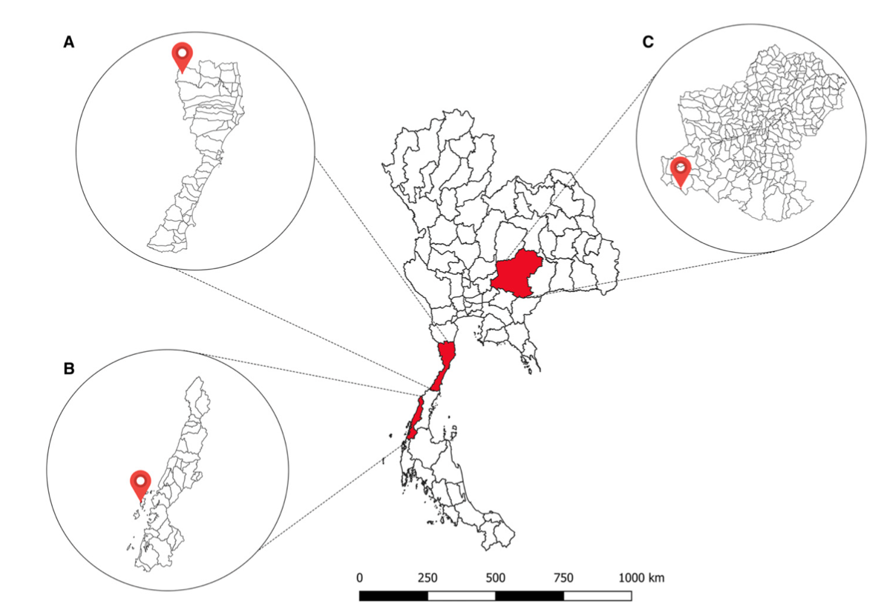
Our finding
“The presence of neutralizing antibody among wild monkeys in Thailand suggests the role of NHPs as reservoir or amplification host for arboviruses”
Stumped-tail macaque
Long-tailed macaque
Pig-tailed macaque

Slide 8
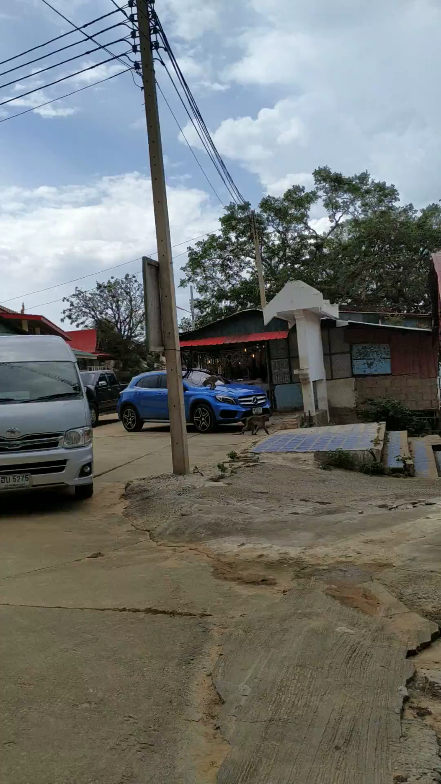
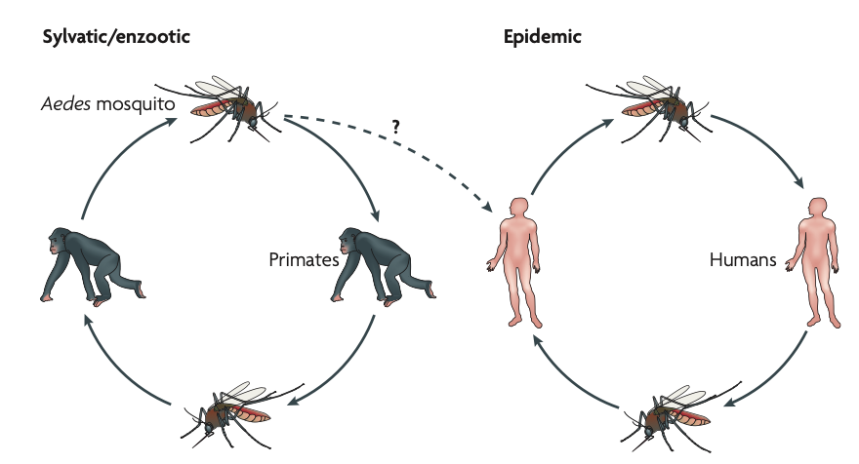
Focusing on DENV CHIKV ZIKV and JEV at the animal-human interface
Nature reviews Microbiology 2007; 5: 518 – 528

Slide 9
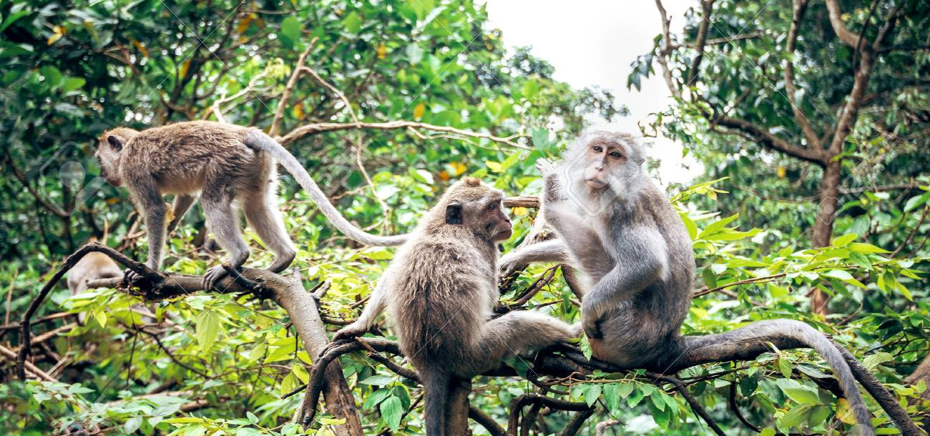
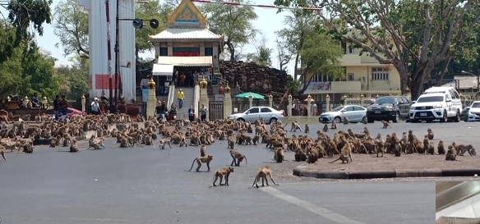
Monkey = Arbovirus reservoir ?
Research Questions
Question 1
Prevalence and Seroprevalence of arboviruses in monkeys living in the national park
Question 2
Prevalence and Seroprevalence of arboviruses in monkeys and humans living in proximity

Slide 10
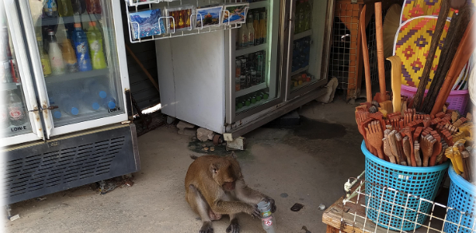
Theoretical Framework
Proponent 1
Arboviruses have been fully adapted to urban cycles and no longer require NHPs, forest mosquitoes, and sylvatic cycle for their maintenance.
Proponent 2
Sylvatic cycles could still have important implications for human infection. NHPs may act as refugia for arboviruses that no longer require NHPs, forest enable re-emergence once human epidemics have passed and immunity in the population has waned.

Slide 11

Our Hypothesis
Hypothesis 1
“NHPs play a role as arboviruses (especially emerging and re-emerging arboviruses” reservoir and the transmission cycles still involve NHPs”

Slide 12
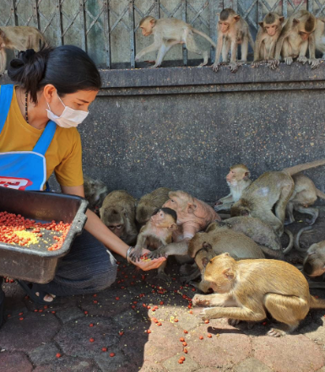
Our Hypothesis
Hypothesis 2
“Similar antibody profile against arboviruses in humans and NHPs living in proximity”

Slide 13
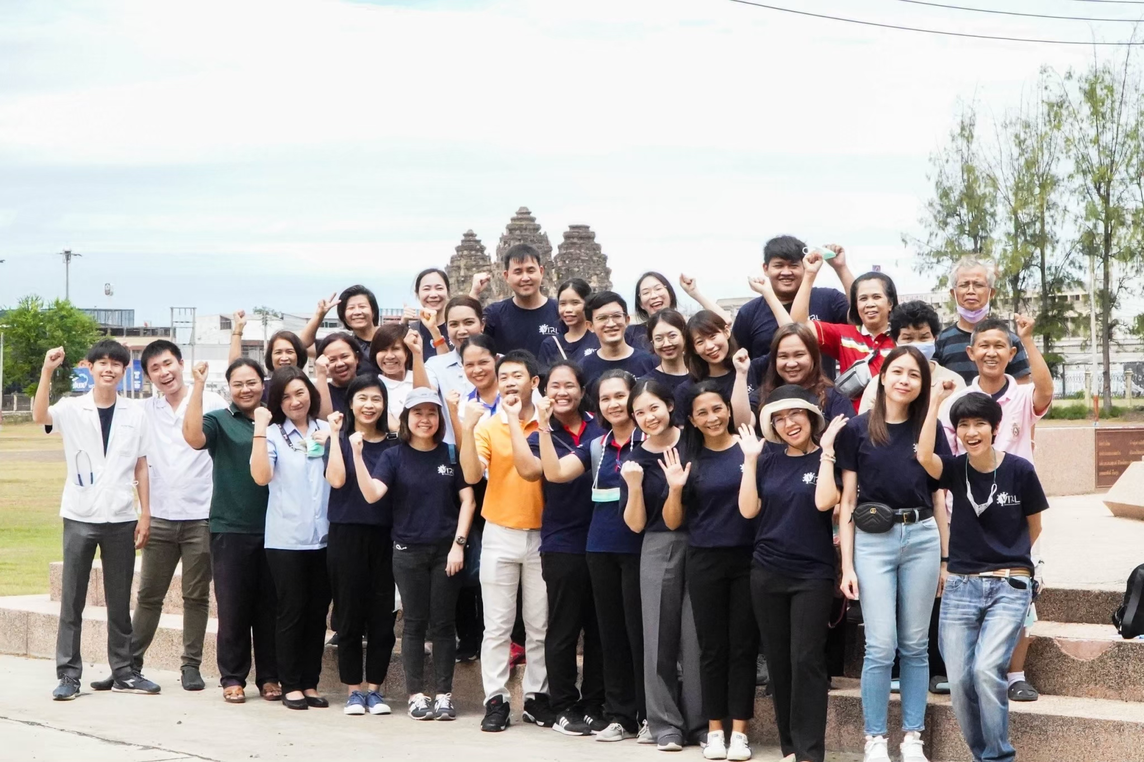
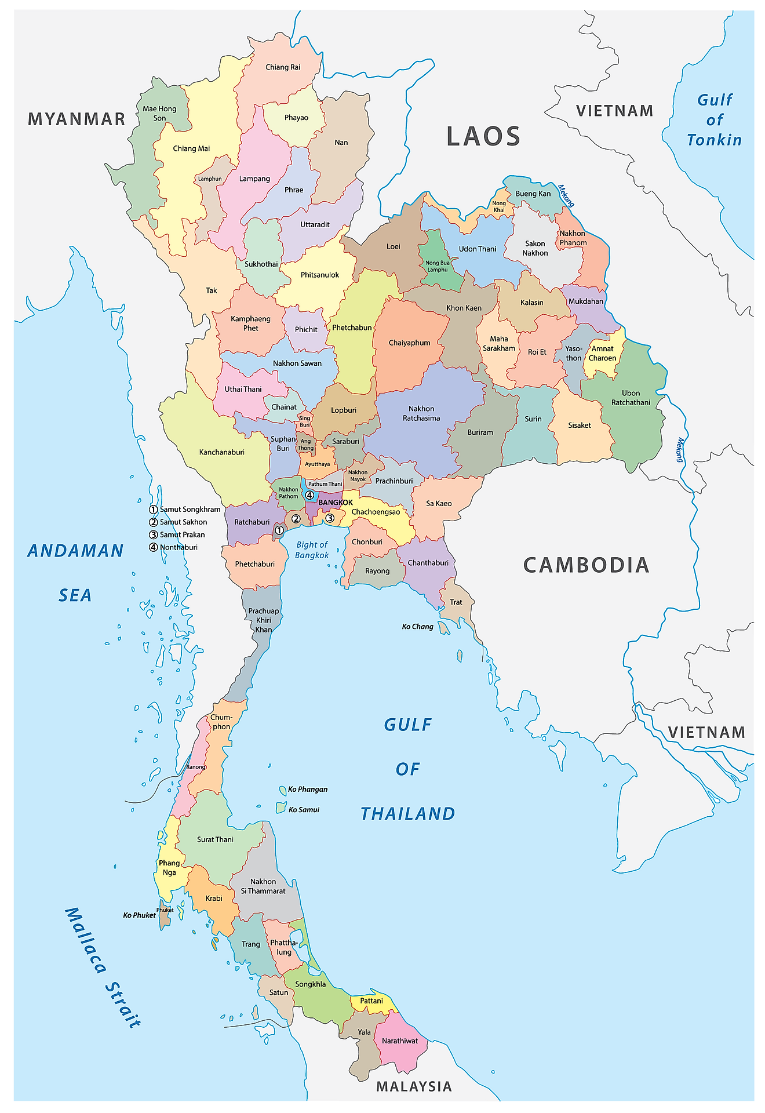
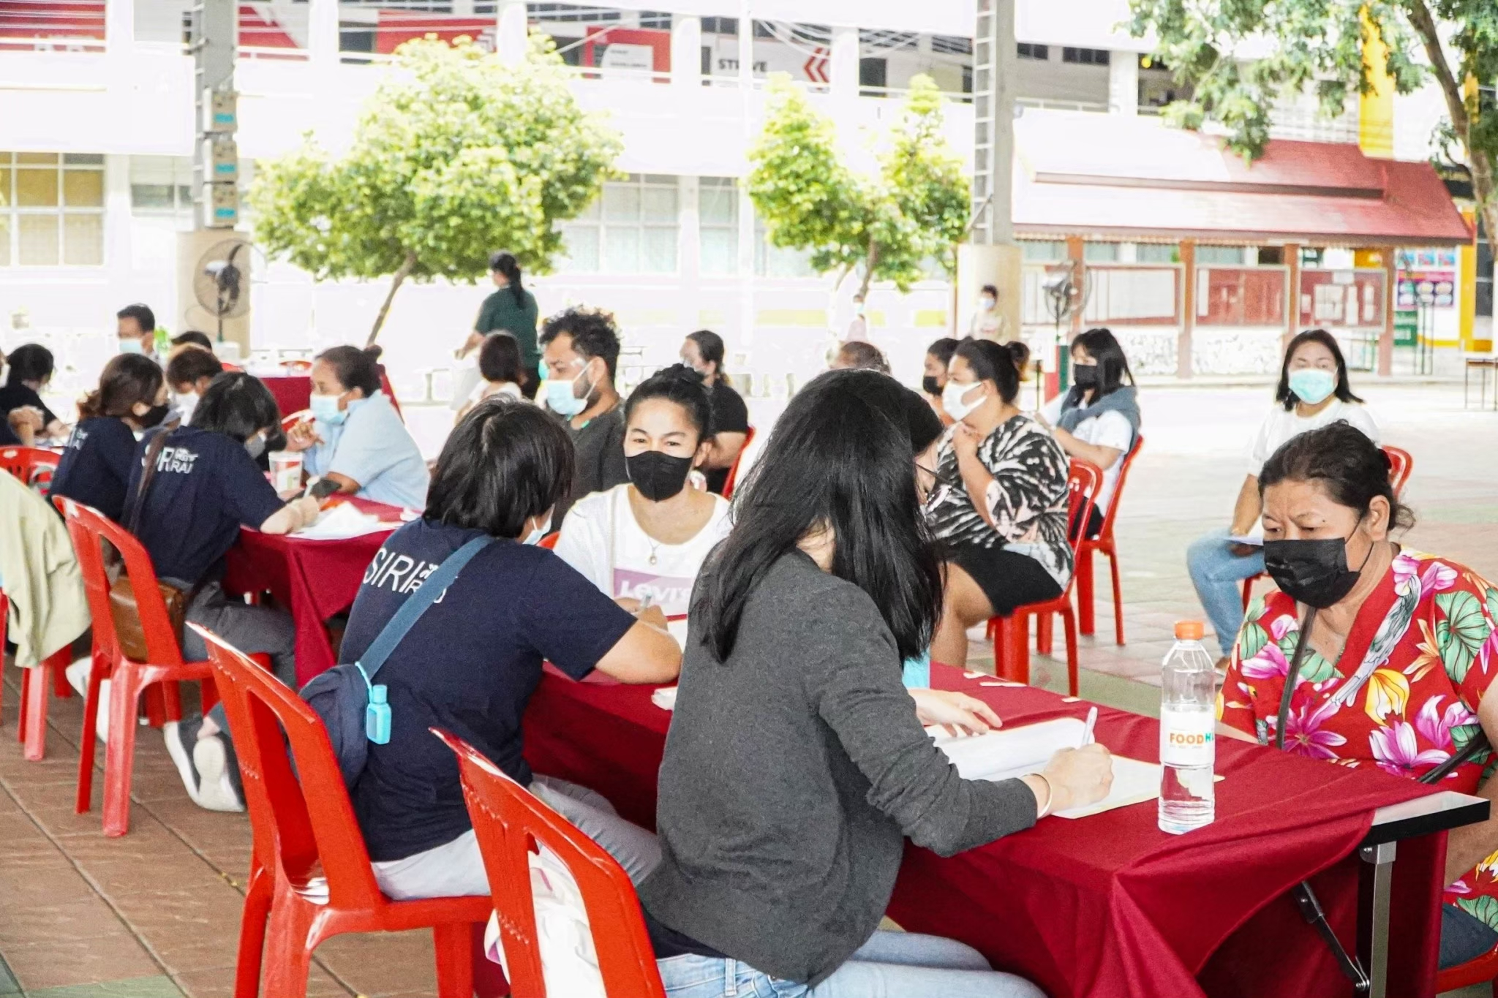
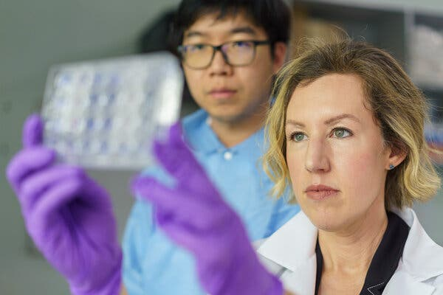
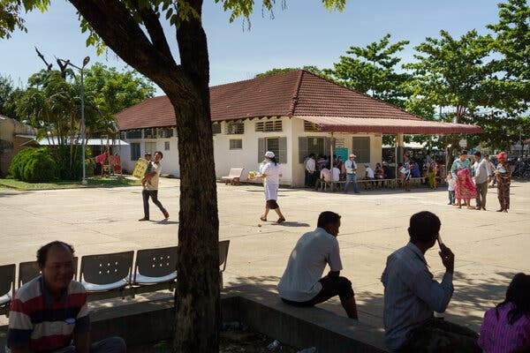
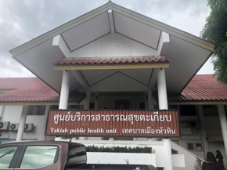
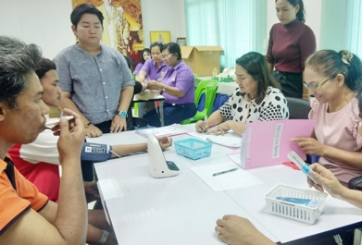
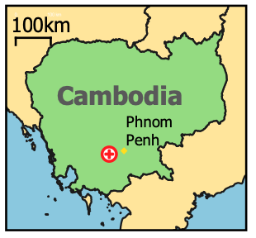
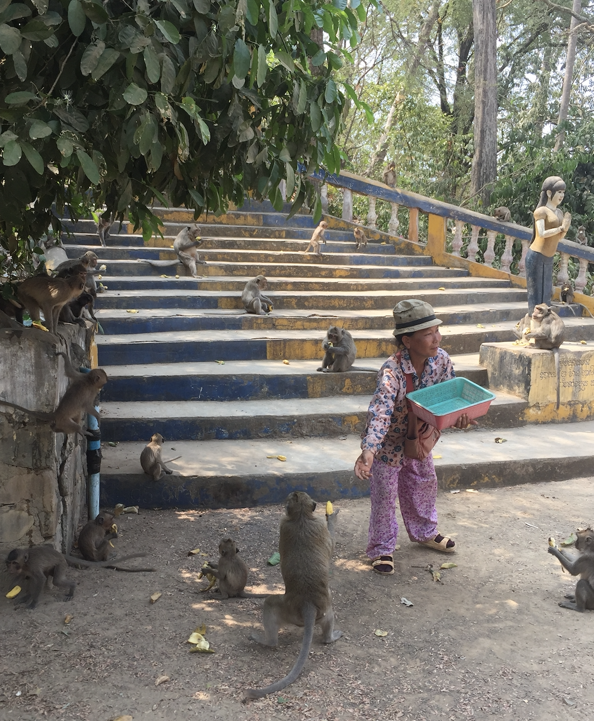
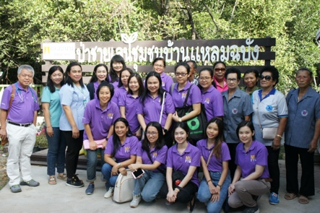
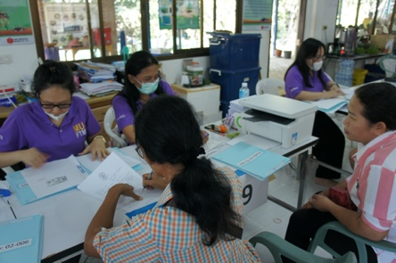
Study sites
Lopburi
Malaria and Vector Research Laboratory,
NIAID, Phnom Penh, Cambodia
Hua Hin
Leamchabang

Slide 14
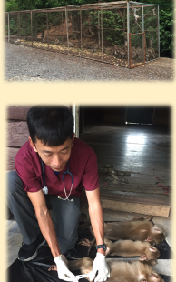
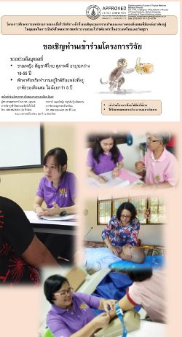
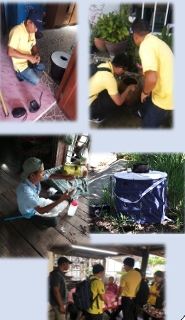
Research Components
01 NHPs
02 Humans
03 Mosquitoes

Slide 15
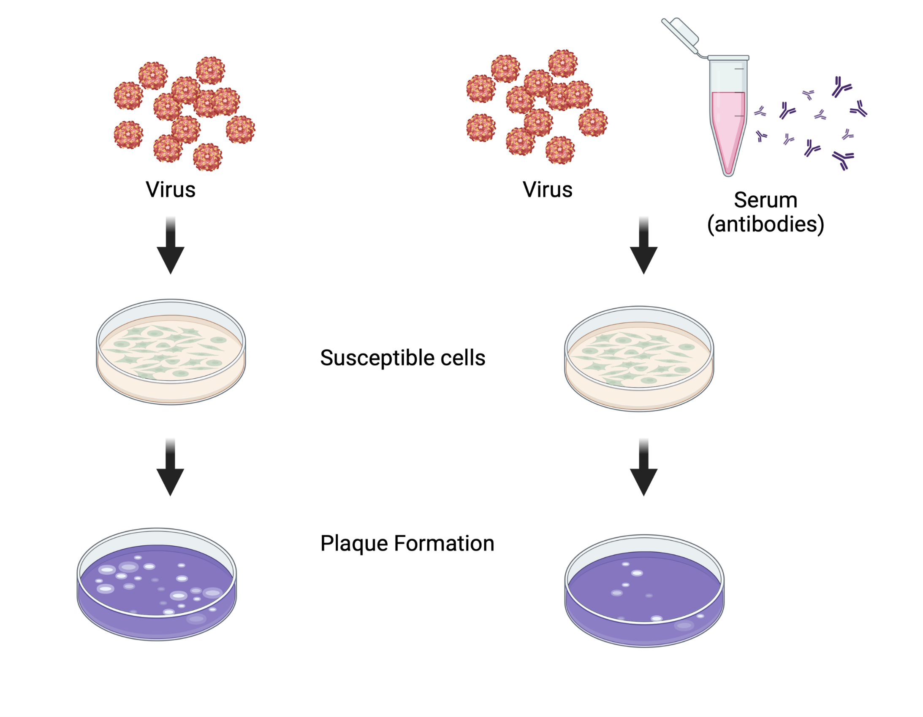
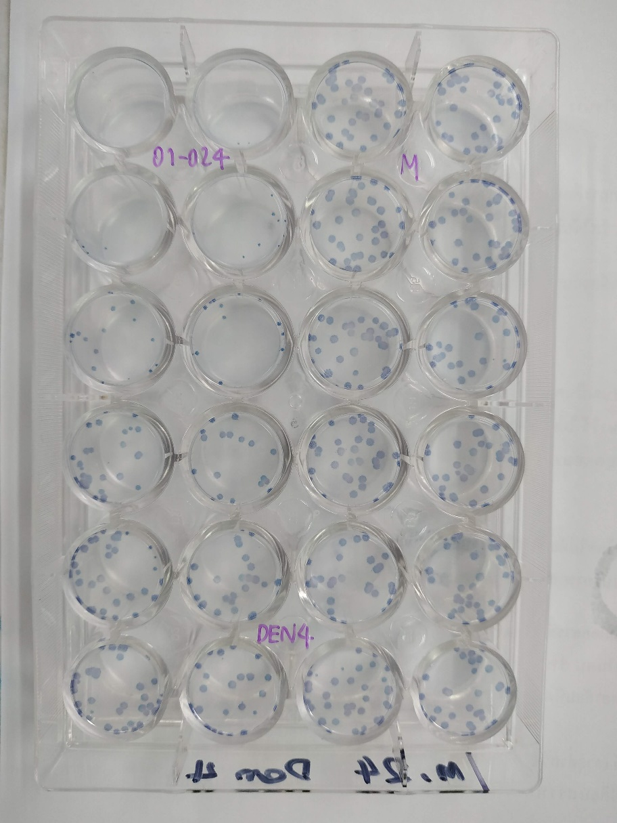
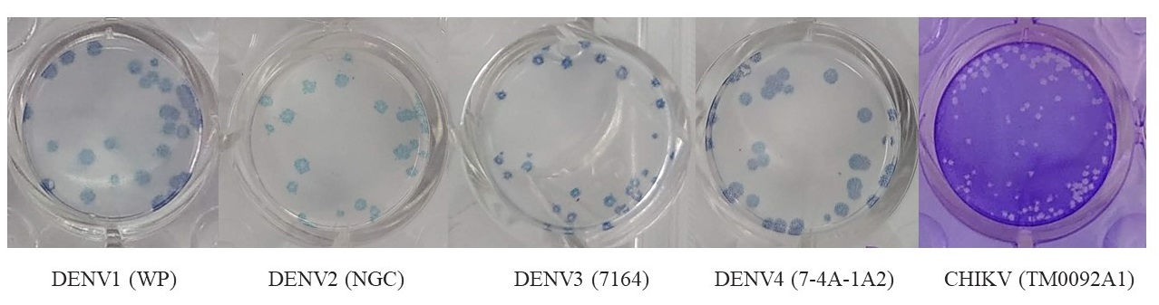
Methodology: Neutralizing antibody detection method
PRNT₅₀
Plaque Reduction Neutralization Test
WHO Gold Standard Method for Neutralizing antibody detection
Sample
Control
neat
1:10
1:40
1:160
1:640
1:2560

Slide 16
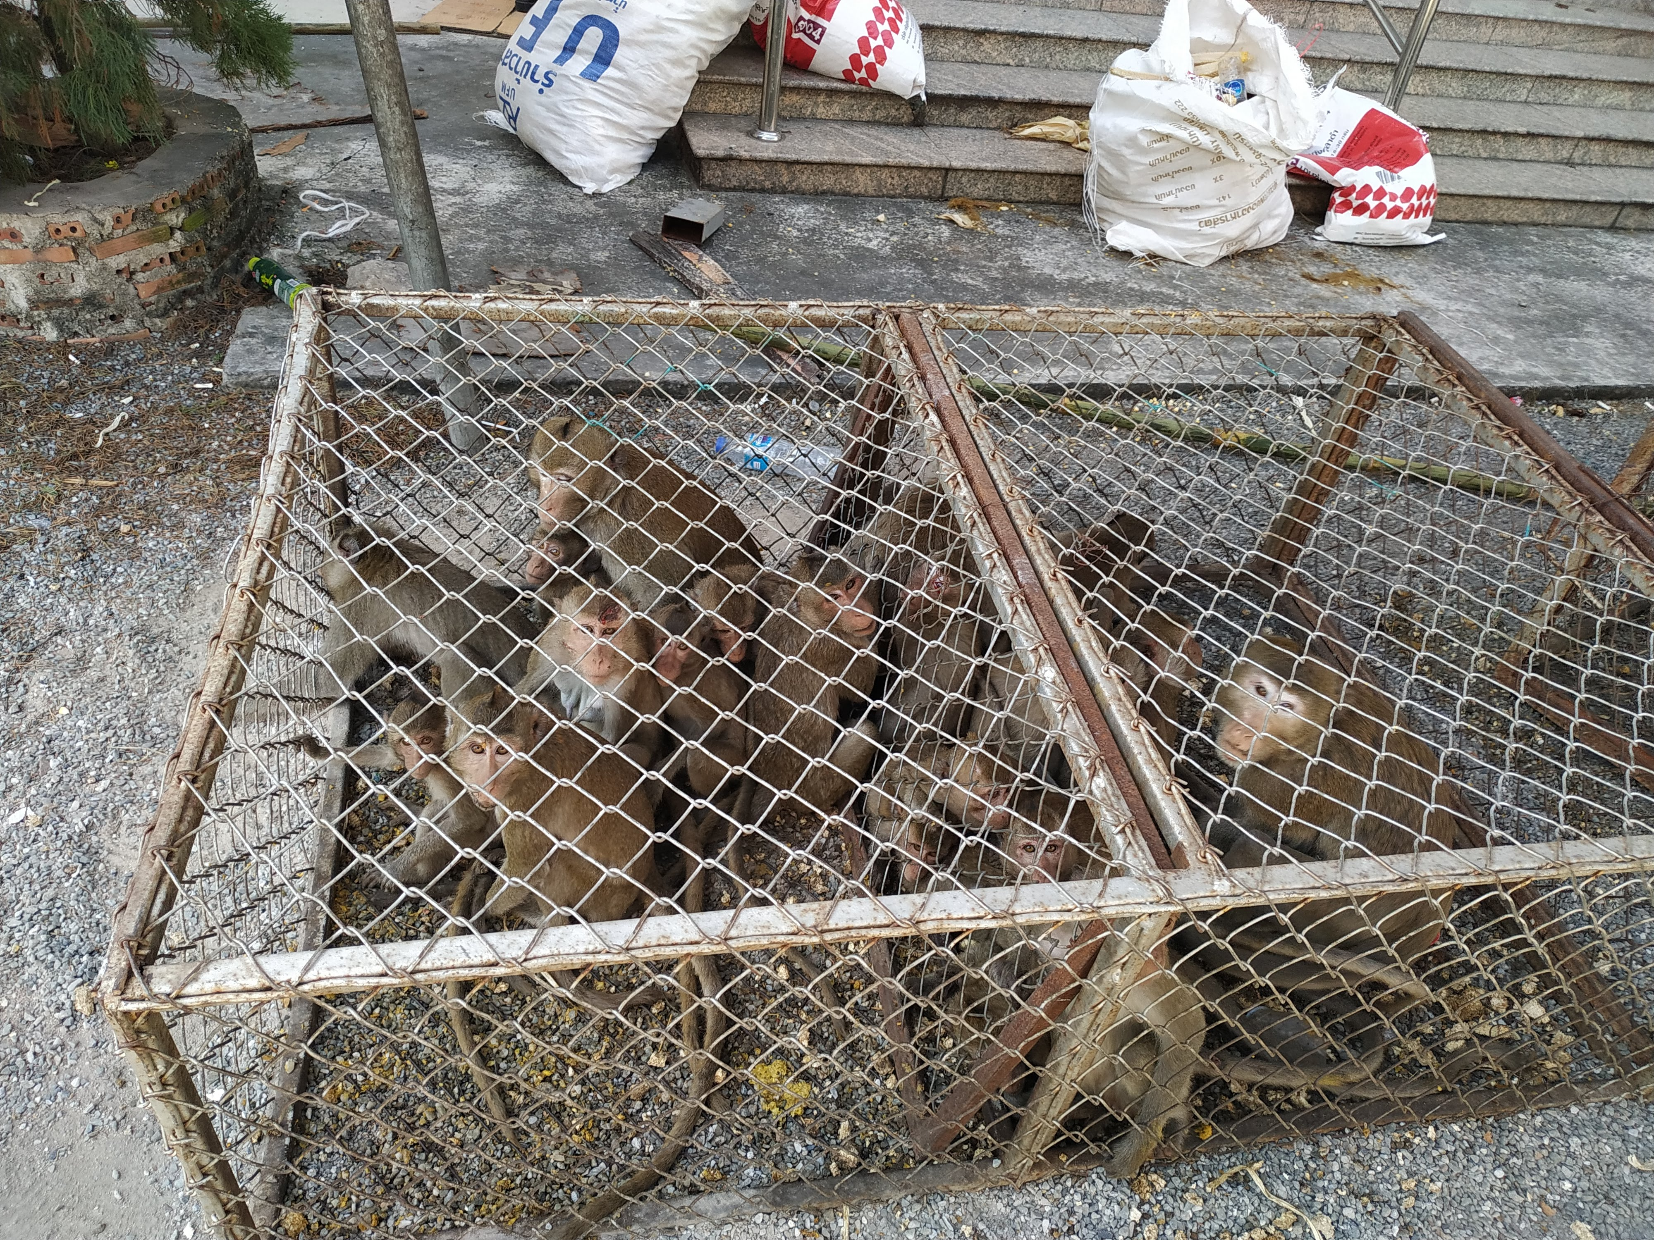
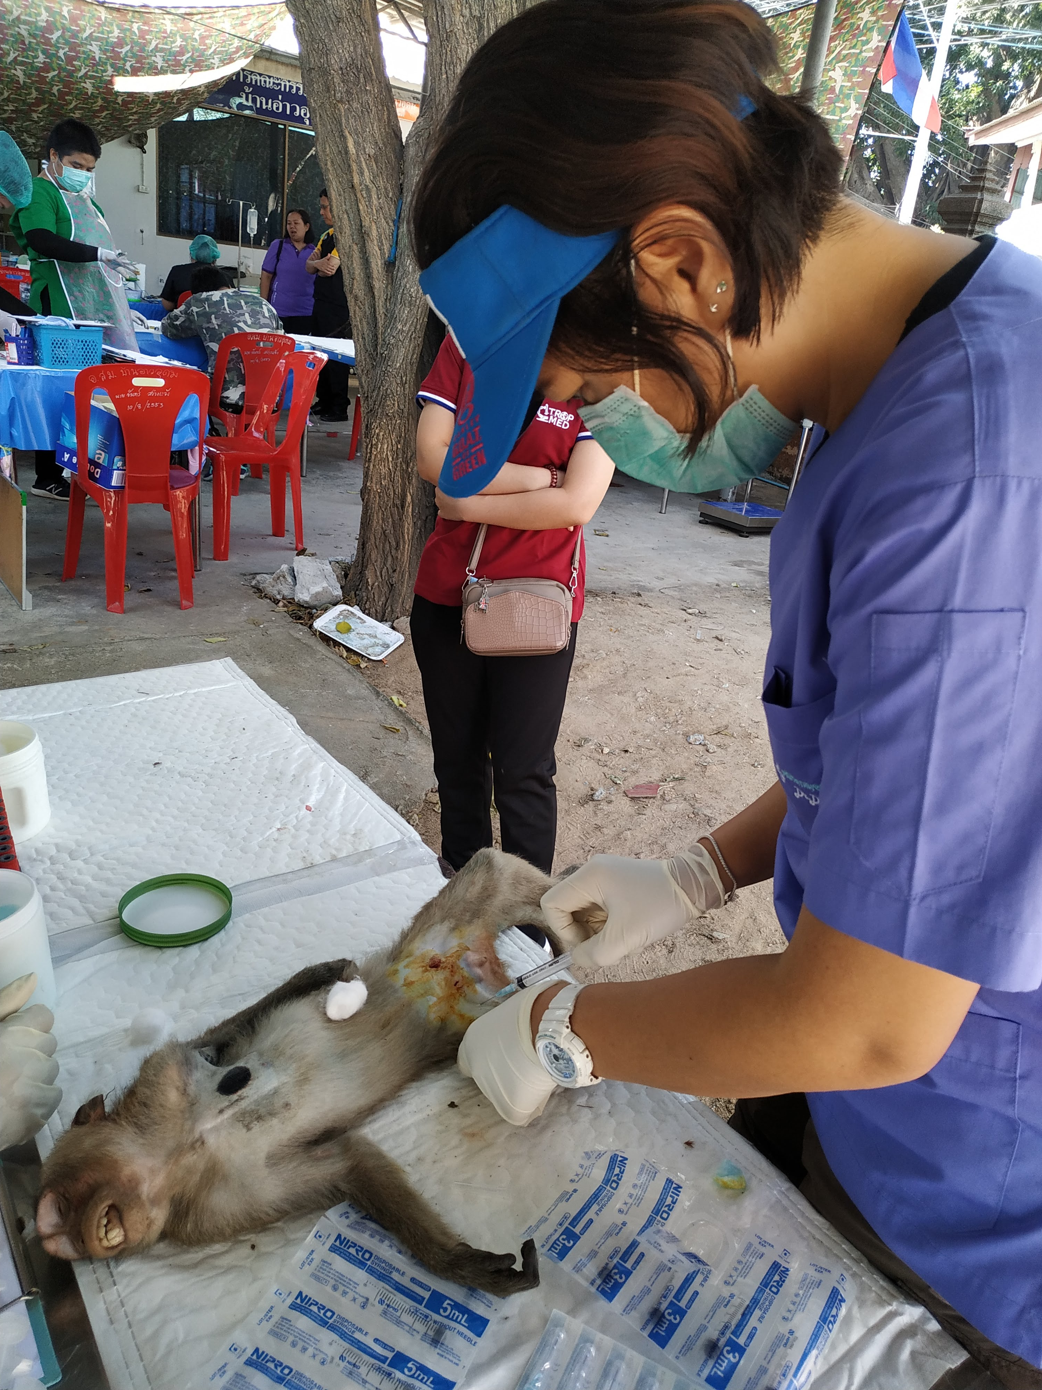
Monkey sample collection
Study site | Age | Gender |  | Total
 |  | Male | Female
Hua Hin (Kao Takieb) | Juvenile | 1 | 16 | 106
 | Adult | 89 | 16
Leamchabang | Juvenile | 40 | 24 | 115
 | Adult | 23 | 28
Lopburi | Juvenile | 15 | 10 | 51
 | Adult | 9 | 17

Slide 17
Neutralizing antibody titer against DENV 1-4 , ZIKV , and CHIKV in NHPs
Leamchabang
Hua Hin
Lopburi
Mongkol N., et al. Manuscript in preparation

Slide 18
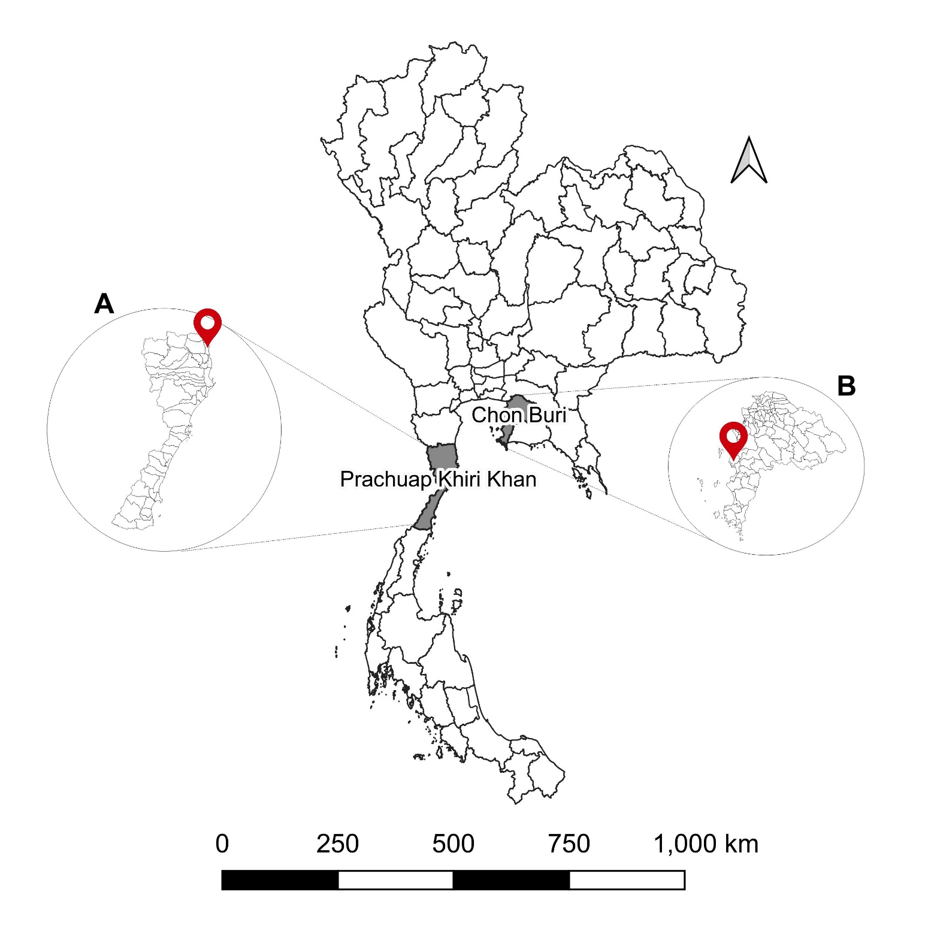
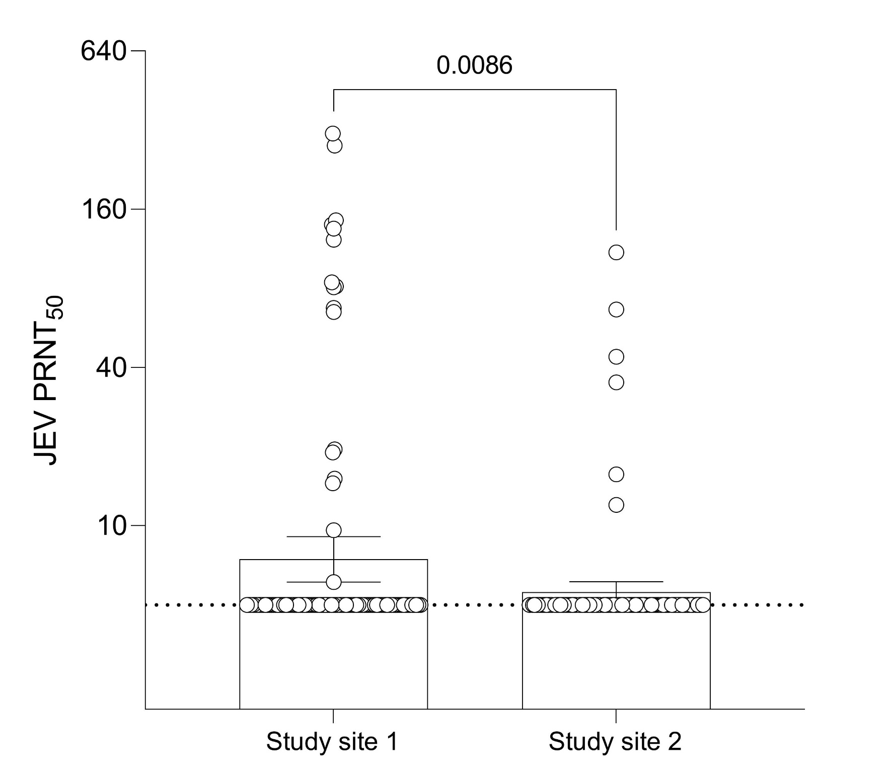
Neutralizing antibody titer against JEV in NHPs
Hua Hin
Leamchabang
Lakhotia D., et al. 2023

Slide 19
Finding I
Low levels of DENV 1-4 neutralizing antibodies in NHPS
CHIKV and ZIKV neutralizing antibodies were detected in NHPs suggesting the role of NHPs as the viral reservoir
The different patterns of antibody responses in NHPs among 3 study sites

Slide 20

Enrollment Steps (I)
Inclusion criteria
Male or Female at age 18-55 years
Live/work within 10 km surrounding monkey habitats for a minimum of 5 years
In good health as evidenced by medical history
Willing to participate and signed consent form
Exclusion criteria
Known of pregnancy at the enrollment visit
Participation in another clinical trial investigating a vaccine or drug in the 6 months preceding enrollment
Report immunodeficiency diseases
Presents with serious chronic illness

Slide 21
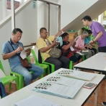
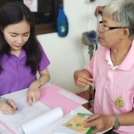
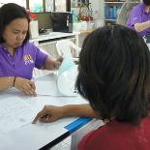
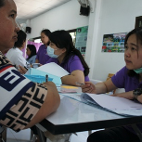
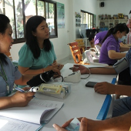
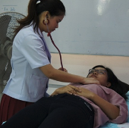
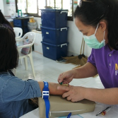
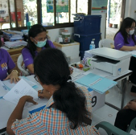
Enrollment Steps (II)
Group informed
Screened
Consented
Questionary
Vital Sign
Physical Examination
Blood collection
Document checking
All pictures were taken following the PDPA act

Slide 22
Participant Demographic Data
Characteristic | Categories | Site1:HH | Site 2: LCB | Site 3:LB
 |  | N (%) | N (%) | N (%)
Gender | Male | 41 (32.5) | 35 (30.4) | 38 (35.19)
 | Female | 85 (67.5) | 80 (69.6) | 70 (64.81)
Age group (Year) | 18-25 | 17 (13.5) | 16 (13.9) | 24 (22.22)
 | 26-35 | 36 (28.6) | 33 (28.7) | 17 (15.74)
 | 36-45 | 37 (29.4) | 21 (18.3) | 28 (25.93)
 | 46-55 | 36 (28.6) | 45 (39.1) | 39 (36.11)
Occupation | Unemployed | 10 (7.9) | 16 (13.9) | 6 (5.56)
 | Government/Private | 29 (23) | 23 (20.0) | 14 (12.96)
 | Business | 27 (21.4) | 25 (21.7) | 41 (37.96)
 | Employee/Contractor | 46 (36.5) | 42 (36.5) | 29 (26.85)
 | Others | 14 (11.1) | 9 (7.8) | 18 (16.67)
Duration of residence (Year) | 1-10 | 39 (31.0) | 19 (16.5) | 8 (7.41)
 | 11-20 | 27 (21.4) | 13 (11.3) | 20 (18.52)
 | >20 | 60 (47.6) | 83 (72.2) | 80 (74.07)
Phase 02
Phase 03

Slide 23
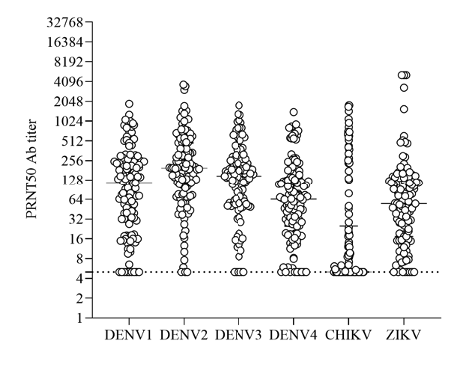
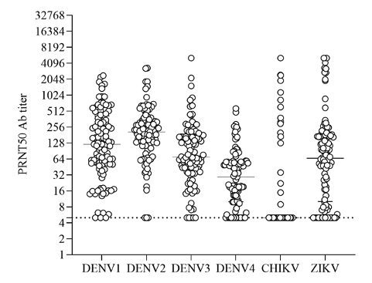
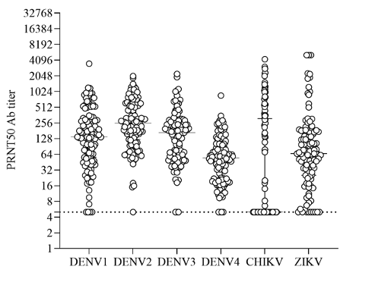
Neutralizing antibody titer against DENV 1-4 , ZIKV , and CHIKV in humans
Hua Hin
6.6%
monotypic
3.1% Naive
Lopburi
15.5%
2 serotype
45.9%
4 serotype
28.9%
3 serotype
Leamchabang
_{Study site} | _{% CHIKV seropositive}
_{Hua Hin} | _{40%}
_{Leamchabang} | _{46%}
_{Lopburi} | _{15%}
Mongkol N., et al. Manuscript in preparation

Slide 24
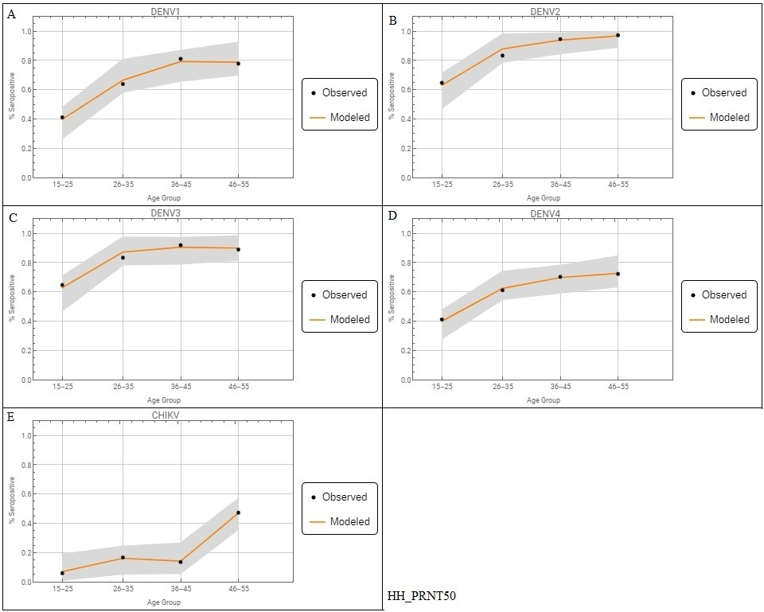
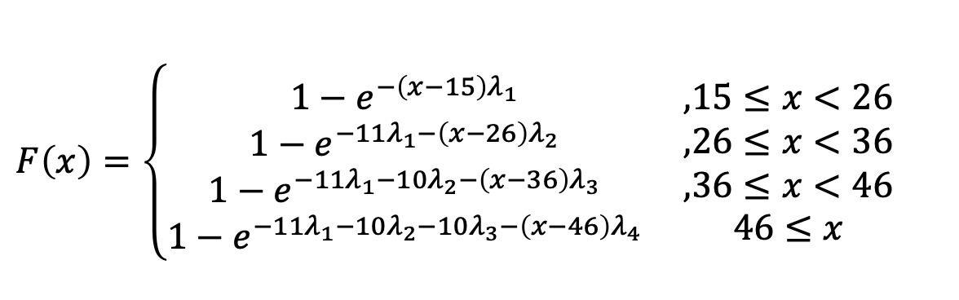
Age-stratified seroprevalence: Hua Hin study site
DENV-1
DENV-2
DENV-3
DENV-4
Phase 02
Phase 03
CHIKV
Mongkol N., et al. Manuscript in preparation

Slide 25
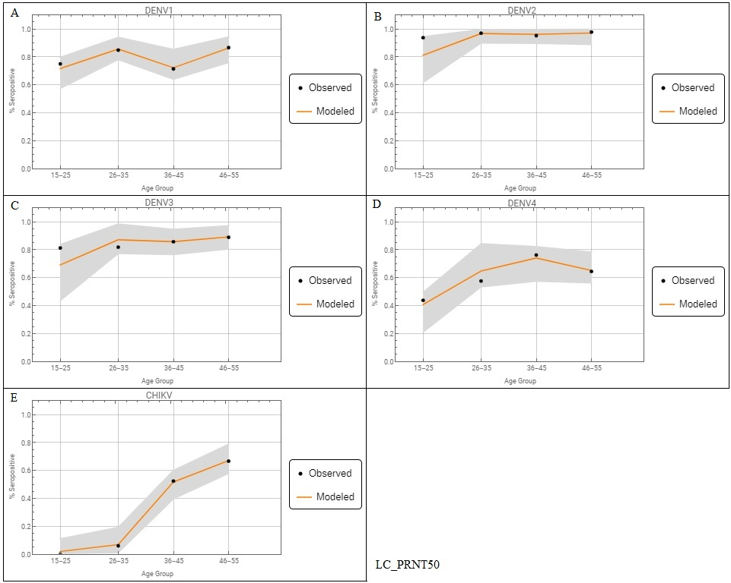
Age-stratified seroprevalence: Leamchabang study site
DENV-1
DENV-2
DENV-3
DENV-4
Phase 02
Phase 03
CHIKV
Mongkol N., et al. Manuscript in preparation

Slide 26

Age-stratified seroprevalence: Lopburi study site
DENV-1
DENV-2
DENV-3
DENV-4
Phase 02
Phase 03
CHIKV
Mongkol N., et al. Manuscript in preparation

Slide 27

Neutralizing antibody titer against JEV in humans
Lakhotia D., et al. 2023

Slide 28
Spatial distribution antibody titers in study site : Hua Hin
DENV-1 Abs
Saliva Abs
DENV-4 Abs
Saliva Abs
DENV-2 Abs
Saliva Abs
CHIKV Abs
Saliva Abs
DENV-3 Abs
Saliva Abs
ZIKV Abs
Saliva Abs

Slide 29
Spatial distribution antibody titers in study site : Leamchabang
DENV-1 Abs
Saliva Abs
DENV-4 Abs
Saliva Abs
DENV-2 Abs
Saliva Abs
CHIKV Abs
Saliva Abs
DENV-3 Abs
Saliva Abs
ZIKV Abs
Saliva Abs

Slide 30
Spatial distribution antibody titers in study site : Lopburi
DENV-1 Abs
Saliva Abs
DENV-4 Abs
Saliva Abs
CHIKV Abs
Saliva Abs
DENV-2 Abs
Saliva Abs
DENV-3 Abs
ZIKV Abs
Saliva Abs
Saliva Abs

Slide 31
Finding II
The majority of the human population in 3 study sites has neutralizing antibodies against DENV 1-4
Neutralizing antibodies against CHIKV and ZIKV were detected in the human population, suggesting previous or ongoing endemic of these viruses in the study sites

Slide 32
Finding II
Association between age and %seropositivity was observed in 3 study sites
A hot spot of arbovirus antibodies was detected nearby the NHP habitat in 3 study sites

Slide 33
Finding III
Approximately 40% of the populations in study sites Hua Hin and Leamchabang have neutralizing antibodies. against CHIKV, but only 18% was observed in the Lopburi study site.
Could not define cross-reactivity of DENV and ZIKV.
Presence of JEV antibody in NHPs and human in proximity

Slide 34




Arbovirus Vectors
Aedes aegypti
Aedes albopictus
Domestic mosquito
DENV, ZIKV, CHIKV?
Peri-urban, rural and forest area
CHIKV
Infected mosquitoes inoculate newly generated infectious virus particles along with mosquito saliva
Virus + Saliva = platelet aggregation, coagulation
and inflammation

Slide 35

Mosquitoes Collection : Hua Hin
Zone 1
Zone 2
Zone 3
Zone 4
Zone | Characteristics
1 | Mountain area inhabited mainly by monkeys
2 | Market area closed to mountain side
3 | Market area closed to canal and villages
4 | Urban area with occasional monkey problem

Slide 36
Mosquitoes Collection : Hua Hin
Genus/Species | Zone |  |  |  | Total
 | Z1 | Z2 | Z3 | Z4
Aedes | 316 | 454 | 760 | 533 | 2063
Aedes aegypti | 272 | 453 | 759 | 530 | 2014
Aedes albopictus | 44 | 1 | 1 | 3 | 49
Anopheles | - | - | 1 | 1 | 2
Anopheles epiloticus | - | - | 1 | - | 1
Anopheles vagus | - | - | - | 1 | 1
Anopheles (Celia) | - | 1 | - | - | 1
Armigeres | - | 3 | 1 | 1 | 5
Armigeres subalbatus | - | 3 | 1 | 1 | 5
Culex | 664 | 2537 | 2397 | 3539 | 9137
Culex jacksoni | - | - | 2 | - | 2
Culex mimulus | - | - | 2 | - | 2
Culex quinquefaciatus | 664 | 2534 | 2390 | 3537 | 9125
Culex sitiens | - | 3 | 3 | 2 | 8
Tripteriodes spp. | - | - | 6 | 6 | 12
Total | 980 | 2995 | 3165 | 4080 | 11220
Zone 3 : CHIKV+ in 3 pools of Ae. albopictus

Slide 37
Finding IV
CHIKV was detected in Ae. albopictus mosquito from study site Hua Hin

Slide 38
Conclusion (I)
Low levels of DENV antibodies in NHPs
CHIKV and ZIKV antibodies
were found in NHPs
Association between age and seropositivity
DENV sustained the urban cycle
NHPs may play a role as a reservoir for re-emerging arbovirus
Need to monitor the infection in young population (vaccine?)

Slide 39

Conclusion (II)
Antibody hotspots nearby NHPs habitat
JEV antibodies in NHPs and humans in proximity
Keep monitoring transmission at the animal-human interface.
More investigation needs to be done

Slide 40


Next Steps…….
Continuing research projects
Potential zoonotic virus detection by metagenomic analysis under the existing collaboration
Longitudinal study at the animal human interface
CHIKaCycle Project : Potential role of CHIKV transmission cycle in forest and urban habitat

Slide 41



Acknowledgements
Mahidol University
NIAID, NIH, USA
National Dengue Control Program, Cambodia
Dr. Patchara Sriwichai
Dr. Jessica Manning
Dr.Vincent Munster
Dr. Steve Whitehead
Dr. Leang Rithea
Mahidol-Oxford Research Unit
Dr. Sompob Saralamba
Johns Hopkins Bloomberg School of Public health, USA
Department of National Park
Wildlife Plant Conservation
Financial Support
eAsia joint research program
NSTDA
Prof. Anna Durbin
Dr. Gittiyaporn Leamsaard
Kasetsart University
Louisiana State University, USA
Dr. Daraka Thongthainan
Dr. Phisanu Tulayakul
Dr.Wirasak Fungfuang
Dr. Rebecca Chrisofferson

Slide 42








Acknowledgements
Viral Immunology Research Laboratory
Faculty of Medicine Siriraj Hospital, Mahidol University
TropMed Team
Nantanida Mongkol
Fanny Saw Wang
Divya Lakhotia

